Slide 1

  This webinar is being recorded
  Please place phones on mute
  Please do not place us on hold; the audience hears the hold music
  Type your questions in the chat box
  A copy of the presentation will be uploaded in PostalPro in the Webinars section

Slide 2
Address Quality Management for PCC Leadership
Essex Jct VT PCC Webinar
June 29, 2017
Notes:
2

Slide 3

Agenda
What are the Problems?
What are the Causes?
Pub 28
How Bad is It?
IM®IM Tool

Slide 4
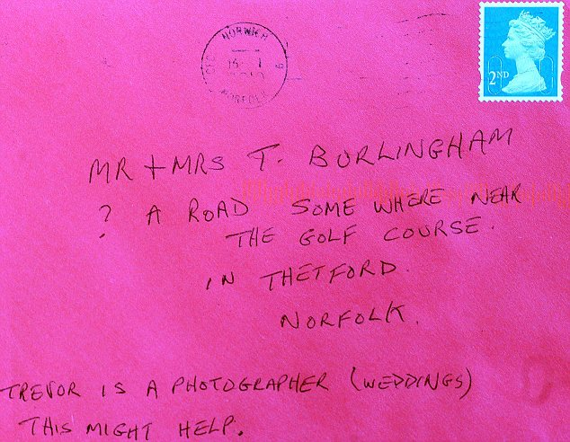
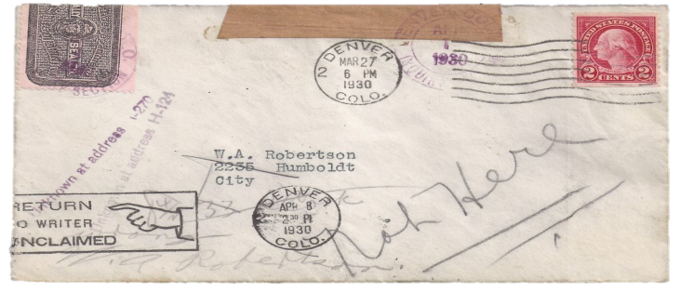
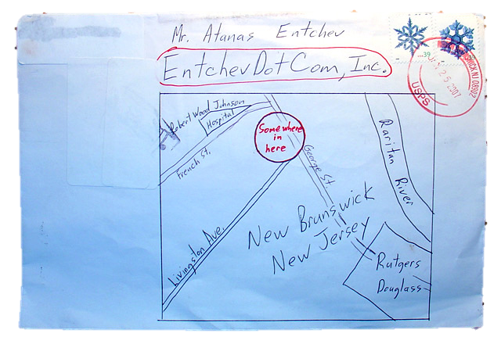
What’s the problem?
Undeliverable-As-Addressed (UAA) Means the Mailpiece Cannot Be Delivered to Either the Address or to the Recipient Shown on the Mailpiece and Must Be:
  Forwarded to New Address
  Returned to Sender
  Discarded as Waste

Slide 5
What are the causes?
People, Families, & Businesses Relocate
Addresses are not checked during data entry
Erratic formatting of address information in address database
Misspelled words or improper abbreviations
Missing or wrong street directional, prefix, or suffix
Missing/incorrect secondary information
City, state, or ZIP Code™ incomplete, missing, or wrong
A “physical” address is required
Multiple or wrong name
Extraneous information or spaces

Slide 6
Proper or Improper Address???
MATT HELM
67 THUNDER LN
SPRINGFIELD VA 22192-3405
FIRST CLASS
ZIP+4
US POSTAGE PAID
CHICAGO ILL
PERMIT NO 1
MATT HELM
67 THUNDER LN
SPRINGFIELD VA 22192-3405
FIRST CLASS
ZIP+4
US POSTAGE PAID
CHICAGO ILL
PERMIT NO 1
IMPROPER
IMPROPER
ABC COMPANY
SUITE 201
SPRINGTIME WY
02740-3461
ALAN’S LAWN SERVICE
TO: ALAN
SUITE 201
100 MAIN ST.
SUNSHINE, S.D.
02740-0000
ATTN: JIM
MATT HELM
67 THUNDER LN
SPRINGFIELD VA 22192-3405
FIRST CLASS
ZIP+4
US POSTAGE PAID
CHICAGO ILL
PERMIT NO 1
MATT HELM
67 THUNDER LN
SPRINGFIELD VA 22192-3405
FIRST CLASS
ZIP+4
US POSTAGE PAID
CHICAGO ILL
PERMIT NO 1
IMPROPER
IMPROPER
Checkmate Apparel
100 King W Ste 201
PO Box 250
Checkerboard AL 02740-3461
Attn Sir Arthur Rook
ATTN MR GROUPER
FRESH FISH MARKET
6 LOBSTER CLAW STREET
SUITE 201
FISHING POLE UTAH 02740-3461

Slide 7
Proper or Improper Address???
MATT HELM
67 THUNDER LN
SPRINGFIELD VA 22192-3405
FIRST CLASS
ZIP+4
US POSTAGE PAID
CHICAGO ILL
PERMIT NO 1
MATT HELM
67 THUNDER LN
SPRINGFIELD VA 22192-3405
FIRST CLASS
ZIP+4
US POSTAGE PAID
CHICAGO ILL
PERMIT NO 1
IMPROPER
IMPROPER
Attn: Hazel
123 North Lane #a
Tree Texas 02740-3461
GHI RESTAURANT
5000 N.E. WILLIAMS AVE.
SPRINGHILL, WA 90867-7632
IMPROPER
MATT HELM
67 THUNDER LN
SPRINGFIELD VA 22192-3405
FIRST CLASS
ZIP+4
US POSTAGE PAID
CHICAGO ILL
PERMIT NO 1
MATT HELM
67 THUNDER LN
SPRINGFIELD VA 22192-3405
FIRST CLASS
ZIP+4
US POSTAGE PAID
CHICAGO ILL
PERMIT NO 1
PROPER
SBC CAMPAIGN
PO Box A
ATLANTA GEORGIA
02740-3461
CUTE OWLS
RM 2390
9 NORTH HOOT LN
WATERPARK FL 33300-0023

Slide 8
Proper or Improper Address???
MATT HELM
67 THUNDER LN
SPRINGFIELD VA 22192-3405
FIRST CLASS
ZIP+4
US POSTAGE PAID
CHICAGO ILL
PERMIT NO 1
MATT HELM
67 THUNDER LN
SPRINGFIELD VA 22192-3405
FIRST CLASS
ZIP+4
US POSTAGE PAID
CHICAGO ILL
PERMIT NO 1
IMPROPER
PROPER
MRS POLISH AT FINGERNAIL SALON
23 TIP LANE
MANICURE, GEORGIA
MOTORCYCLE RIDERS
FL 8
71 CANAM RD
YAMAHA CA 99487-6632
MATT HELM
67 THUNDER LN
SPRINGFIELD VA 22192-3405
FIRST CLASS
ZIP+4
US POSTAGE PAID
CHICAGO ILL
PERMIT NO 1
MATT HELM
67 THUNDER LN
SPRINGFIELD VA 22192-3405
FIRST CLASS
ZIP+4
US POSTAGE PAID
CHICAGO ILL
PERMIT NO 1
PROPER
IMPROPER
BABY BLANKETS
523 KNITTING CIR
CROCHET LANE NC 23876-3201
DOGGIE DAY CARE
5130 98 TER SE
PUPPY LANE PA 13480-3461

Slide 9

Postal Standards for Addressing
Delivery address
  all CAPITAL letters
  Font in Arial 12 Point
  No punctuation unless part of the address
  Left justified
Secondary addresses also are abbreviated and appear on the same line as the address line. If it doesn’t fit, then you place it above not below the address line. Examples are: RM, FL, APT, or STE (Suite) Number. The pound sign (#) should not be used if the correct designation, such as APT or STE, is known.
Recommend to always use a return address.
Attention Line (ATTN: optional) always goes above the company name.
USPS HQ PCC
YOUR ADDRESS
YOUR CITY YOUR STATE ZIP CODE
The delivery address line includes either the street address, the PO Box number or the highway contract route number.
SUE GREEN
GREEN THUMB NURSERY
STE 501
100 N EASY ST
LITTLE ROCK AR 72201-1212
Street suffix names and directionals need to be abbreviated. Examples are: AVE, ST, TER, CIR, PL, BLVD and your directionals are N (North), S (South), E (East), or W (West). If its part of the address name then you don’t abbreviate.
The last line is reserved for the city, state and ZIP Code. Use only the two-letter abbreviation for states. One space between the City and State and two spaces between the state and ZIP+4 Code.
For best results, always use the ZIP+4 Code. If it doesn’t fit then it goes as the last line.

Slide 10
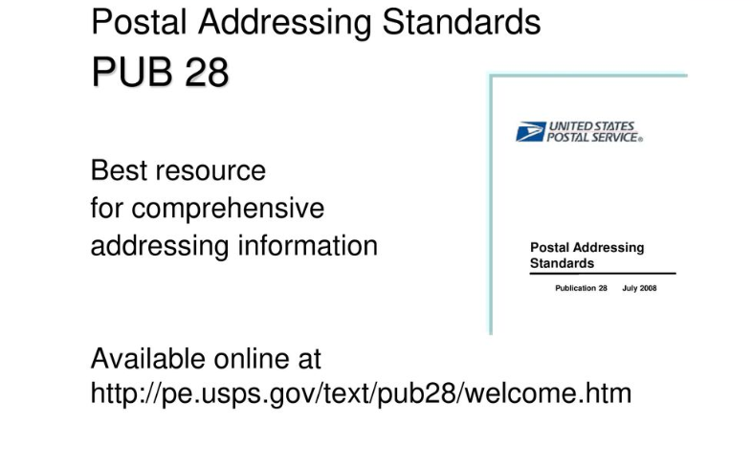

Slide 11





How bad is it?
Return 58¢ / pc.
1.275 Billion pieces
$744 Million
Original Address
New Address
Forward
25¢ / pc.
844 Million pieces
$209 Million
Waste .068 / pc.
3.796 Billion pieces
$258 Million

Slide 12
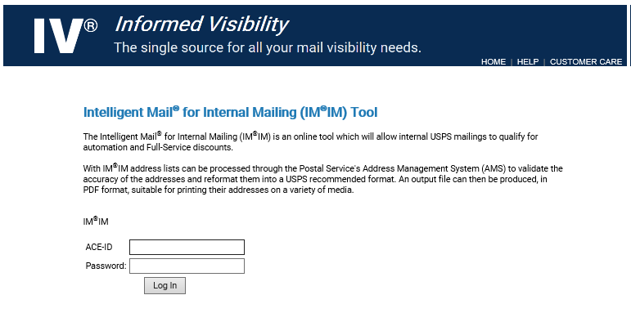
What can you do?
Move Update
ACS™
ANK^{Link}®
CASS™
Suite^{Link}®
LACS^{Link}®
DPV®
NCOA^{Link}®

Slide 13
Intelligent Mail for Internal Mailing
imim.usps.gov

Slide 14
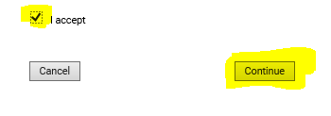

Slide 15
Intelligent Mail for Internal Mailing (IMIM) Tool
IMIM Tool is an application designed to facilitate producing Intelligent Mail barcode, IMb, mail pieces.
By relying on a Web Browser, IMIM Tool removes the need to install and maintain specialized software and fonts on workstations to produce an IMb. The IMIM Tool produces PDF documents suitable for printing on labels, Envelopes and 8 1/2 x 11 letter size documents.

Slide 16
IMIM Tool offers these functions:
Select a MailerID. Use the "Find a Finance Number" and the corresponding MailerID when generating an IMb barcode. Search for a Finance Number by entering a six-digit Finance Number, project description, or organization name, a ZIP Code, or a combination of a City and State. Although there is a default value for a MailerID, it is preferable to use a MailerID associated with a project or organization.
Produce a single mail piece. Enter a name and destination address; validate the address via AMS and produce a PDF file formatted for labels, envelopes or 8.5" x 11" documents.
Produce multiple mail pieces. Produce multi-page PDF documents by uploading and processing two types of files--comma-separated values and MS Word. Each entry should have a minimum of two and a maximum of five address lines. In the case of MS Word, blocks of addresses are separated by one or more blank lines. There is a limit of 10,000 address blocks.

Slide 17
Printing PDF files. In Acrobat, select "Print" from the File menu. In the print window, ensure Page Scaling is set to "None". Also, select the checkbox next to "Choose Paper Source by PDF page size." Click Print.
The IMIM Tool has been tested and adjusted to perform in the following browsers: Internet Explorer 7 & 8; FireFox; Chrome and Safari.
If you have any questions or need assistance, please contact Intelligent Mail Support.

Slide 18
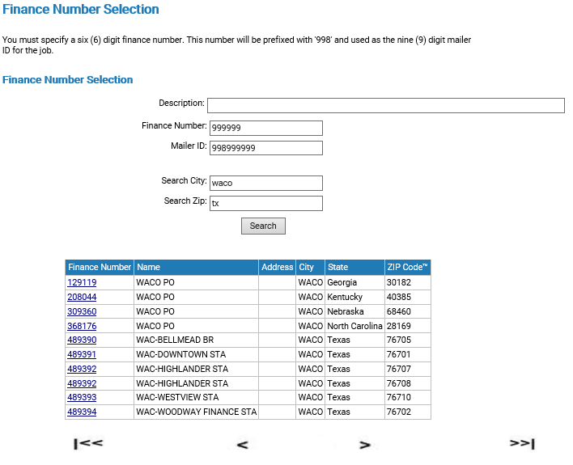

Slide 19
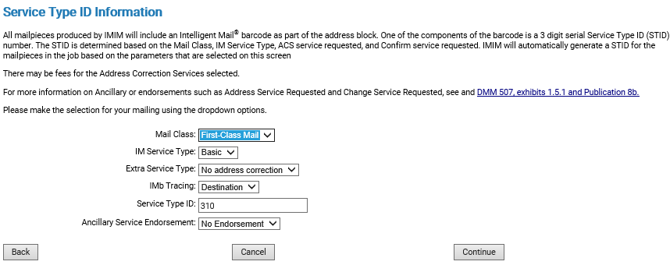

Slide 20

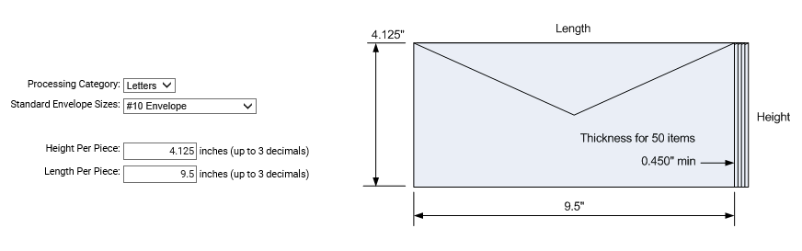

Slide 21
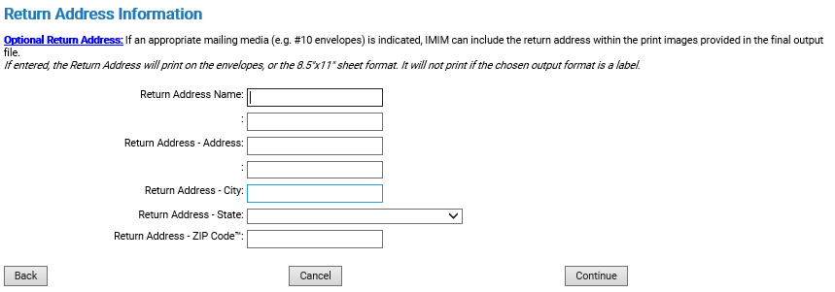

Slide 22
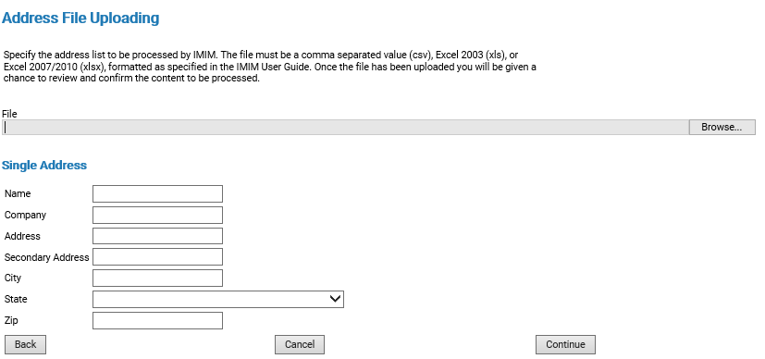

Slide 23
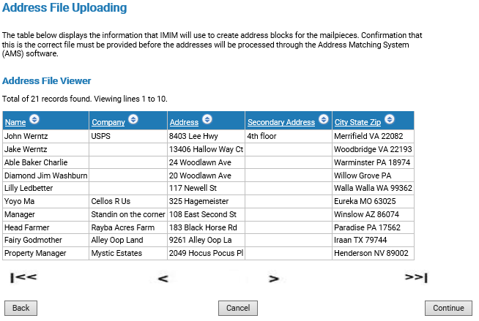

Slide 24
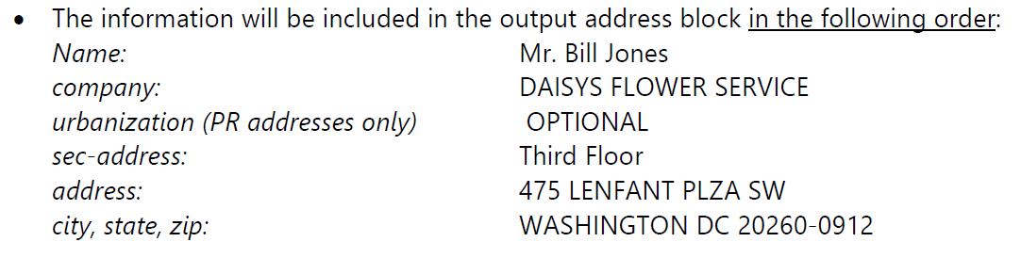
Spreadsheet Field Options

Slide 25
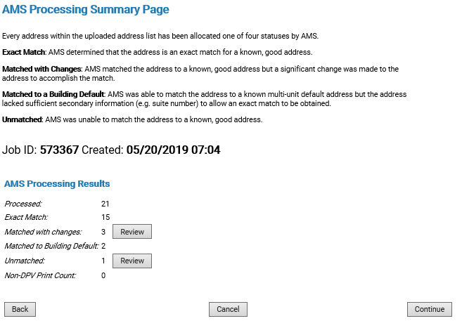

Slide 26
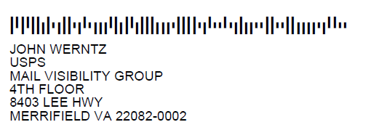
Exact Match

Slide 27
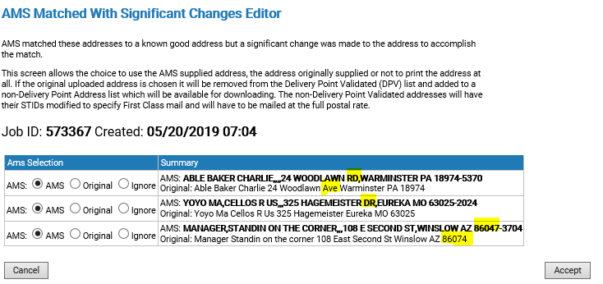

Slide 28
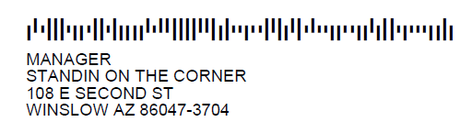
Matched with changes

Slide 29
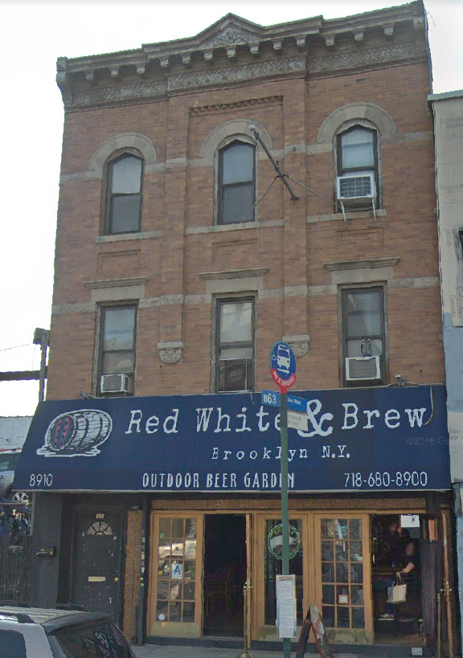
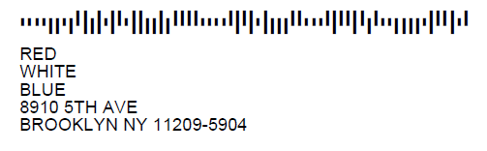
Matched to Building Default

Slide 30
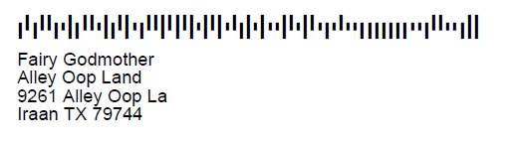
Unmatched

Slide 31
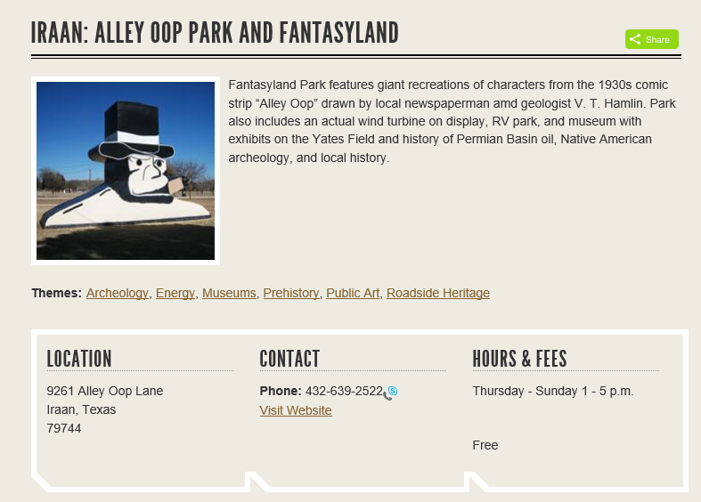
Unmatched

Slide 32
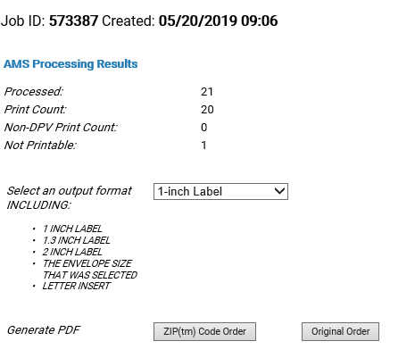

Slide 33

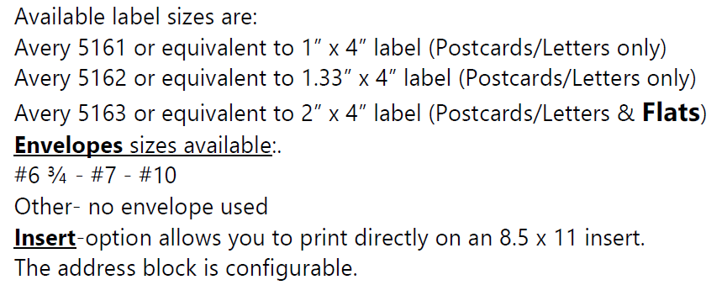

Slide 34
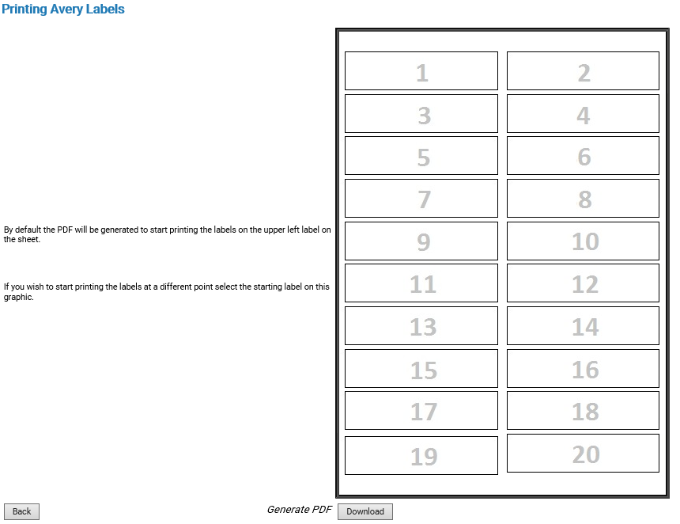

Slide 35
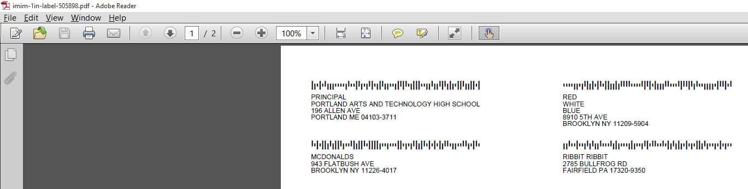
One inch labels

Slide 36
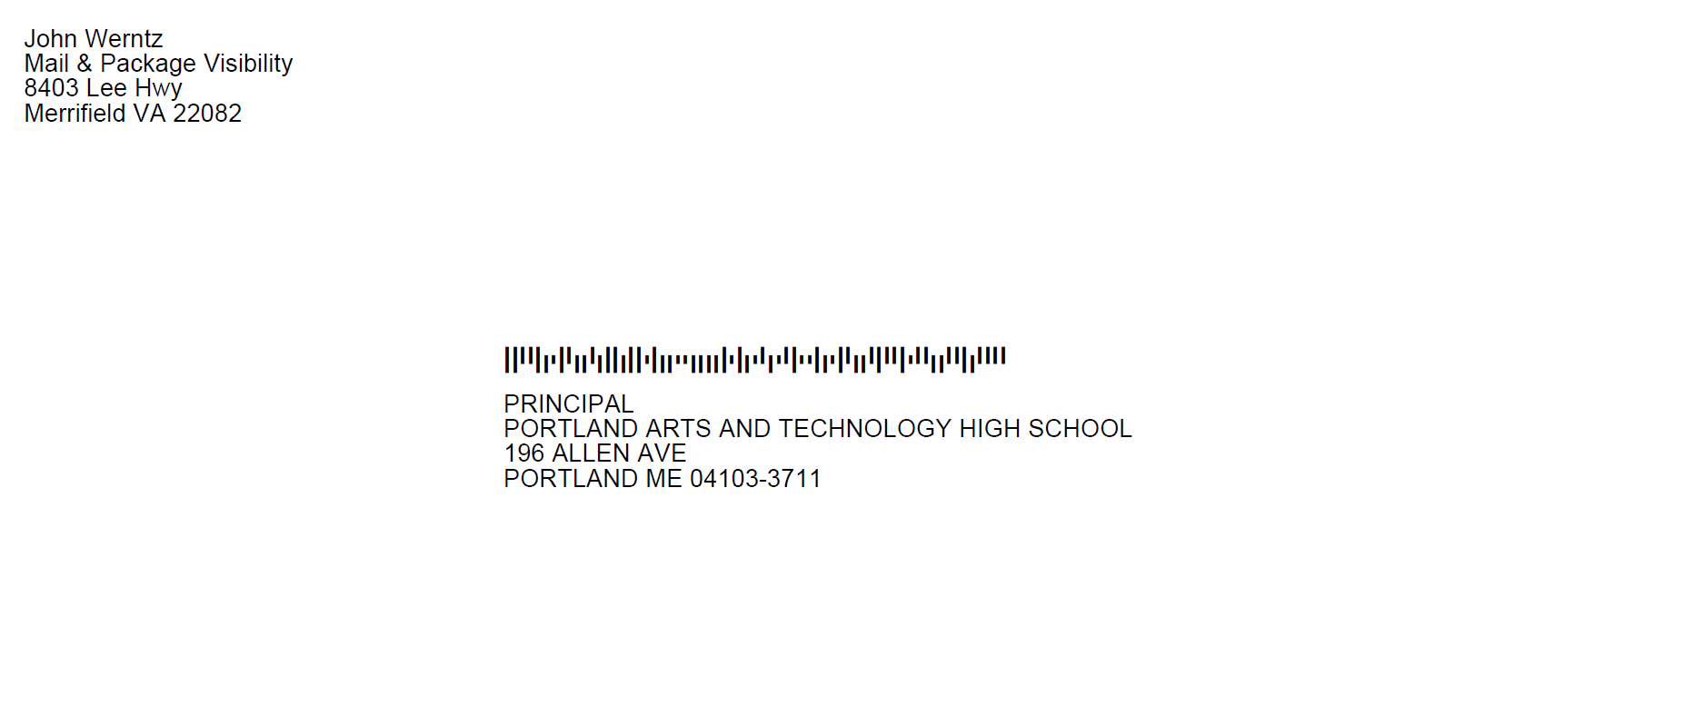
#10 Envelope

Slide 37
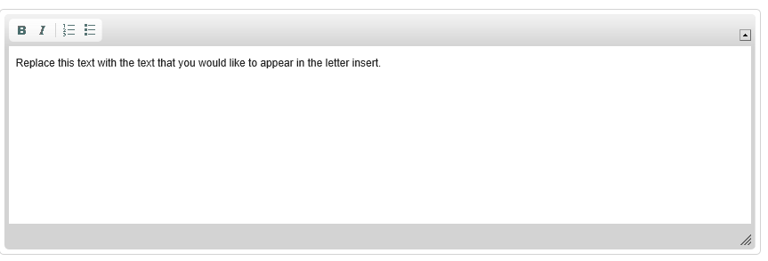
Letter Insert

Slide 38
Letter Insert
Mail Piece Layout
Features that are available include: TEXT bolding and italics, numbering and bullets
Also inserts of the following text is available using:
  $addressblock for the entire AMS corrected address
  $name for the first line of the address
  $date inserts the current date in the text message
  $imbno inserts the decode IMb in text format.

Slide 39
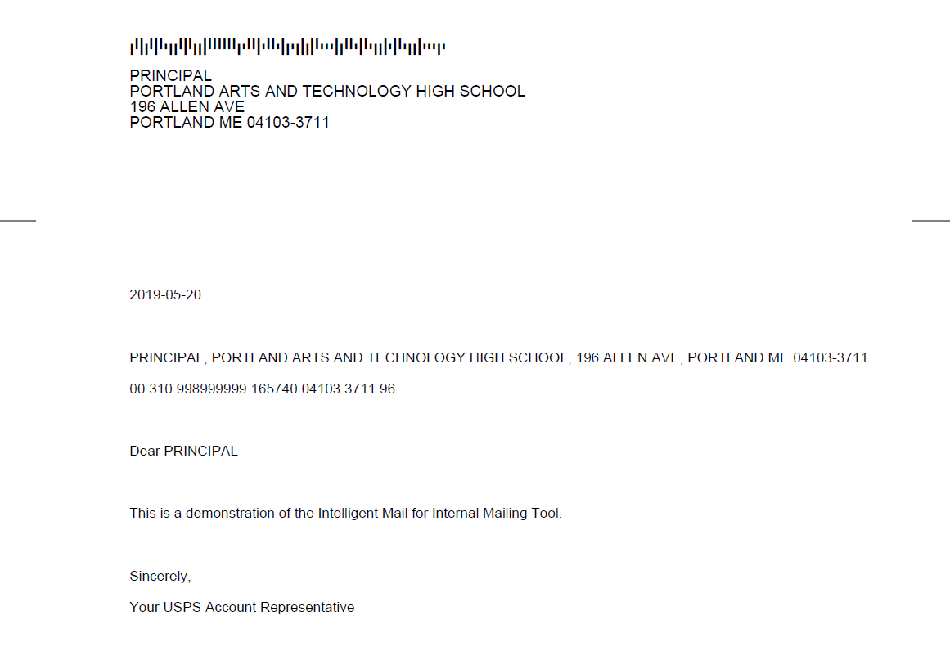
Letter Insert

Slide 40


